Slide 1

Is there a Correlation between the incidences of fraud vs. the Spending Size, Population Size, Age Group and Demographics?
The Newbies
An analysis of credit card fraud claims

Slide 2

Meet The Team!
Taib Diallo
Yuanfeng Xu
Alexis Hernandez
Mary Jane Rafol

Slide 3

Data Cleaning and Preparations
API’s and Dataset Used
Spilt columns
Checked data types
Checked for incomplete rows
Further cleaned based on analysis

Slide 4


Objective
Claim
Null Hypothesis (H₀)
There is no correlation between the victim’s age, spending size, demographics, and time of transaction vs. fraud incidences.
Credit card fraud remains the no. 1 payment method for perpetrating fraud based on the Federal Trading Commission 2020 Annual Report.
Determine if there is a correlation between the incident rate and victim’s age group, spending size, demographics, and time of transaction so that awareness campaigns can be directed to highly susceptible groups.
Alternate Hypothesis (H_{a})
There is strong positive correlation between victim's age, spending size, demographics, and time of transaction vs. fraud incidences.
Alternate Hypothesis (H_{b})
There is strong negative correlation between victim's age, spending size, demographics, and time of transaction vs. fraud incidences.

Slide 5
Methodology
1
2
3
4
Identifying Data Sources & Cleaning of Data
Stratify data by age group, obtain the average spending per user
Generate demographics from Census API
Analyze results
Kaggle’s
Credit Card Fraud Dataset / Census API
Application of Pandas’ cut / bin and groupby functions on Dataset
Census API (pop size, unemployment rate, poverty rate, etc.)
Bar chart, scatter plot and and linear regression

Slide 6
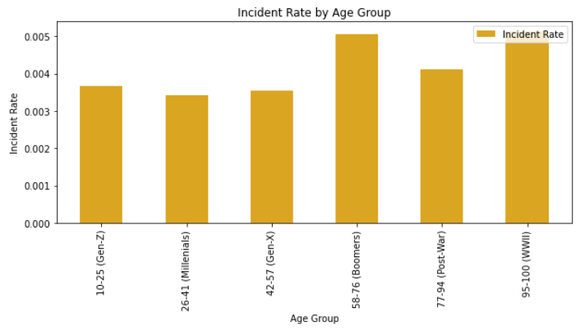
Results #1: Age Group
Our analysis shows that the rate of fraud incidences are higher on credit card users 58-100 yrs. old (Boomers, Post-War and WWII).
This result also supports the premise that older people have wealthier financial status, and they tend to be more trusting and forgetful, increasing their vulnerability and susceptibility as fraud targets.

Slide 7
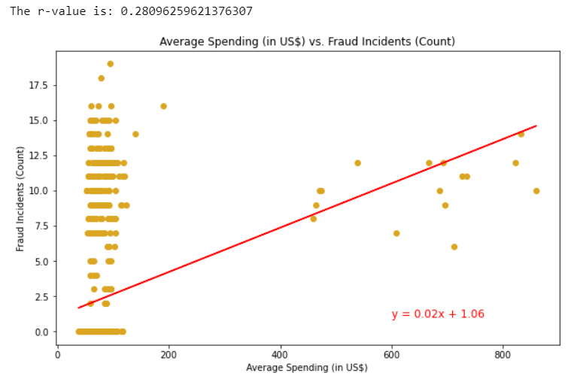
Results #2: Spending Size
Our analysis shows no strong correlation between users average spending and its susceptibility to fraud.
The r-value returns to 0.28, which is closer to 0, suggesting weak correlation between the two variables.

Slide 8
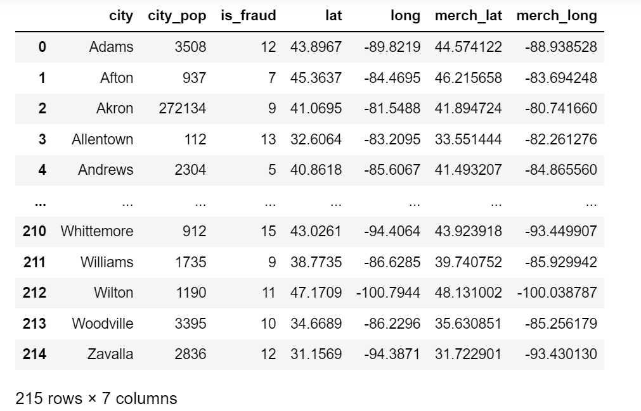
Results #3: Demographics
Is there any relationship between locations and credit card fraud incidences?
Generate the sub-dataset about cities.

Slide 9
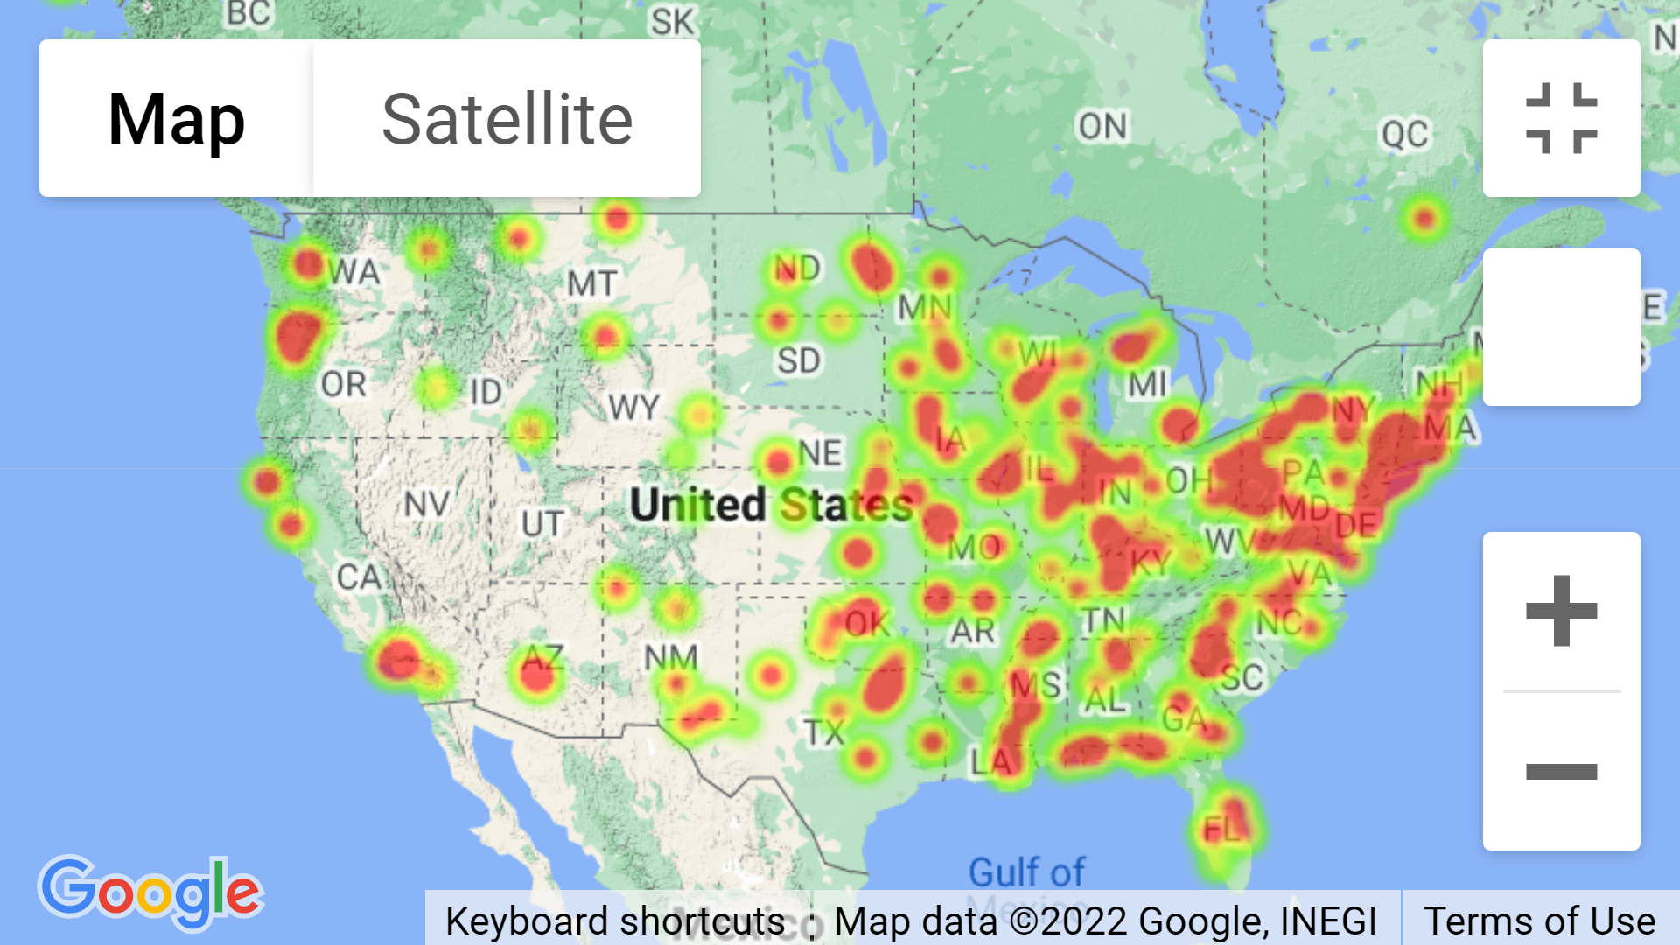
Results #3: Demographics
Heatmap distribution of victim’s locations.

Slide 10
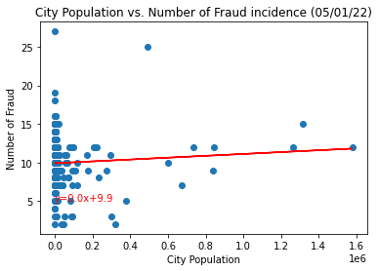
Results #3: Demographics
Hypothesis 1. Big cities that have larger population size tend to have higher fraud incidences.
The r value is: 0.06900267483096204
The r-squared is :0.004761369133827495
Based on the analysis of our dataset, the correlation between city population size and credit card fraud incidences is weak.

Slide 11
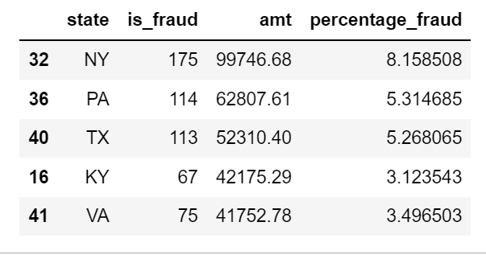
Results #3: Demographics
Top three states with high incidences of fraudulent transactions: NY / PA / TX

Slide 12
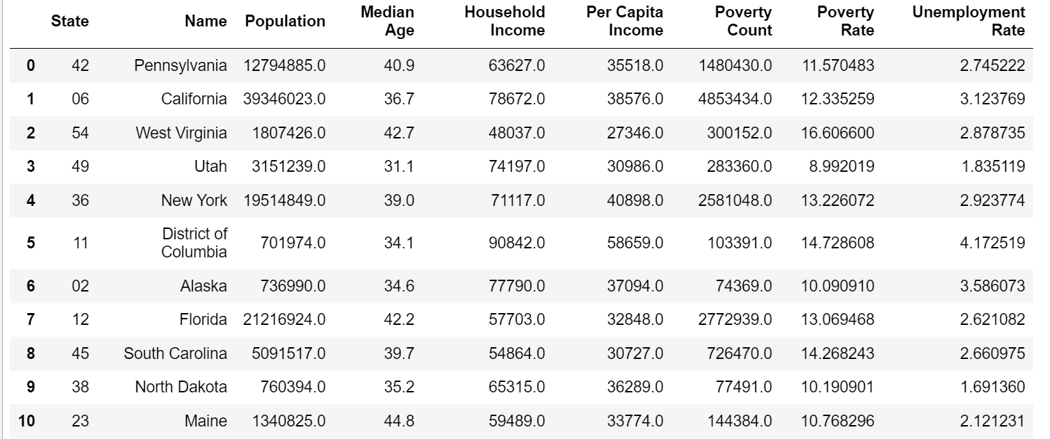
.
Census API:
Get the data about population data and other economic data for all states in 2020.

Slide 13
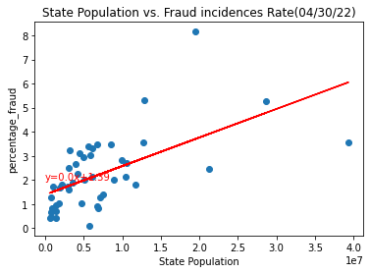
Results #3: Demographics
Hypothesis 2. States that have larger population size tend to have higher credit card fraud incident rate.
The r value 0.59 indicates that state population size is positively correlated with the rate of fraud incidences.
The r-squared shows that the rate of fraud incidence can be explained 35% of the variance by the state population in the regression model.
The Hypothesis 2 is accepted.

Slide 14
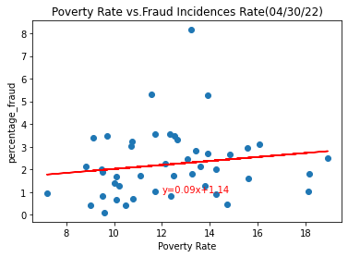
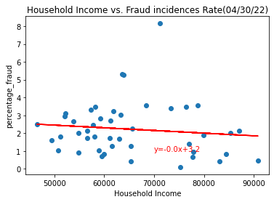
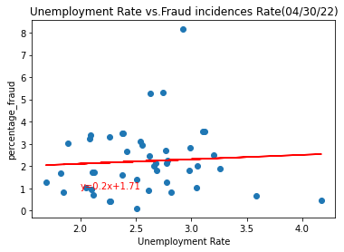
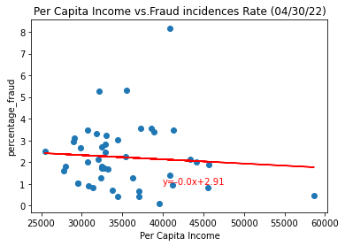
Results #3: Demographics
Hypothesis 3. Socioeconomic status (measured by poverty rate, unemployment rate, household income, per capita income) is correlated with credit card fraud incident rate.
The correlation between socioeconomic status and credit card fraud rate is weak. The r-squared shows that the regression model can not explain the relationship.
The Hypothesis 3 is rejected.

Slide 15
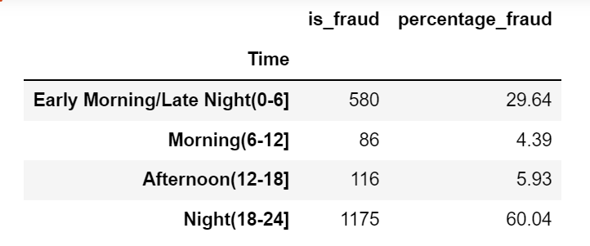
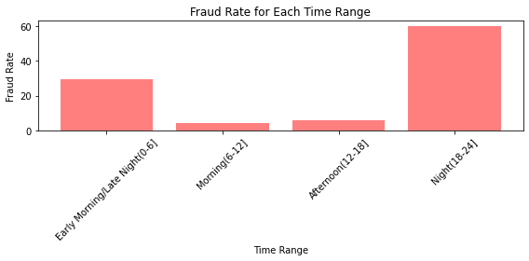
Results #4: Time Frame
Hypothesis 4. Night-time and early morning have more credit card incidence rate.
Based on the analysis, the top three time that has high-frequency of fraudulent transactions: 22 o’clock,, 23 o’clock and 3 o’clock.
Night-time and early morning time tend to have higher credit card fraud incidences rate.
Hypothesis 4 is accepted.

Slide 16
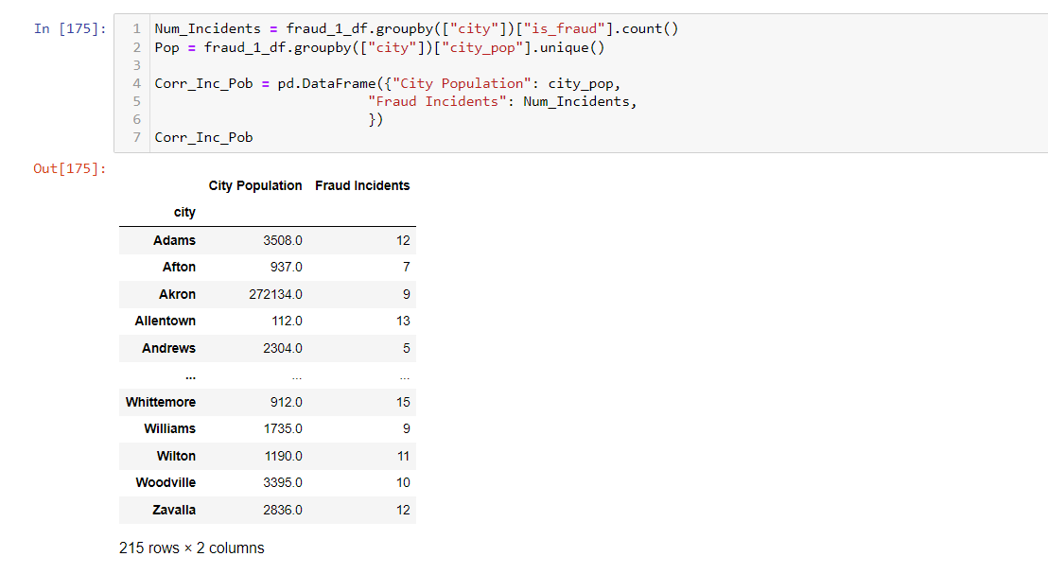
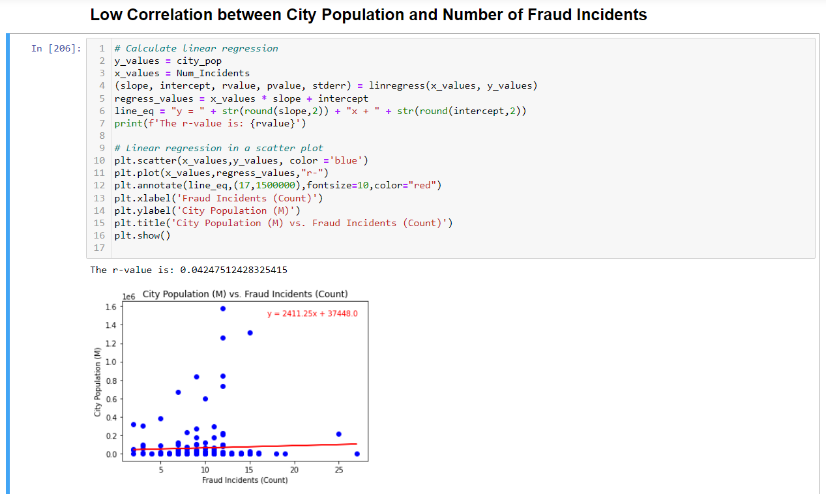
Other Analysis
Looked at data for over 200 cities in US
Shows low correlation
16

Slide 17
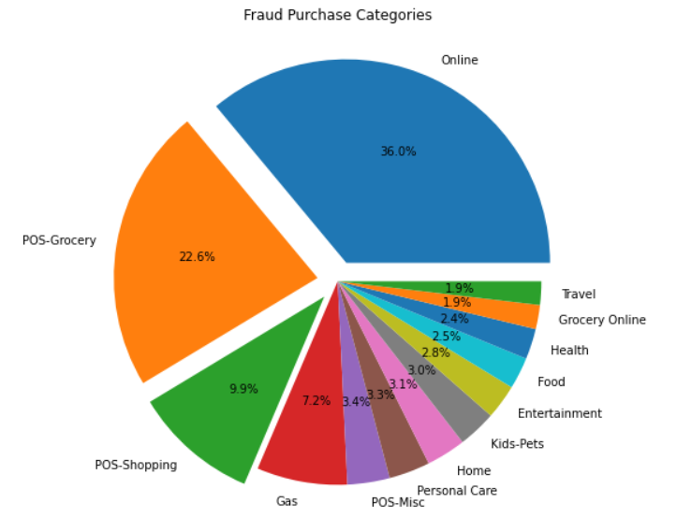
Other Analysis
Purchase Categories vs. Fraud Incidence
Top categories
Online
POS-Grocery
POS-Shopping
Top Categories Age Mean = 51 years
Top Categories Amount Mean = US$ 720
17
17

Slide 18
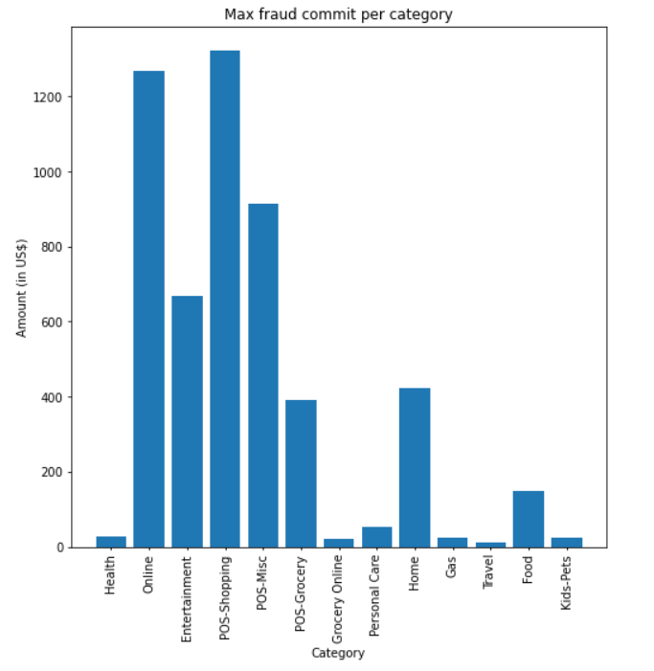
Other Analysis
Average amount of fraud for all transactions reported during the period was $528.
More than a third of all fraud reported during the period were related to online activities.
Online scammers do not discriminate age, is the top category for all age ranges.
Amount average per online fraud reported is $928.
18
18

Slide 19
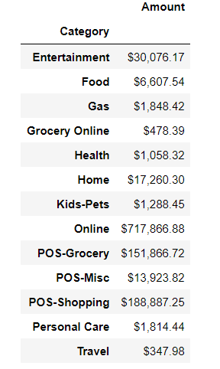

Other Analysis
Amount of Fraud per Categories
During the period studied, the top three categories exceeded one million dollars in fraud.
Frauds credit card not present reach 63% of the total.
19
19

Slide 20
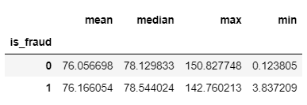
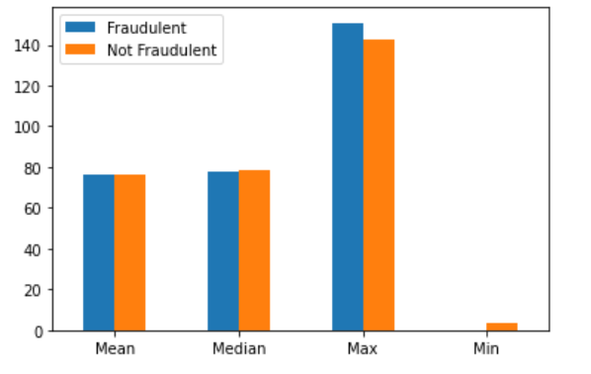
Other Analysis
Distance (km) vs. Fraud
Found distance between locations using haversine function

Slide 21
Other Considerations
Limitations
The dataset is limited to seven months only and does not provide historical data to enable trending per year.
The credit card records do not seem to be distributed reasonably across, cities, age group—analysis could have improved if these limitations are addressed.
The dataset is limited to 45 states and 52 cities

Slide 22
Further Exploratory Analysis
Other Analysis
Opportunities
Gender
Job type
Merchant categories
Develop a code that flags suspicious incidences once transaction meets the following requirements: age of the victim, location of the transaction, amount, card holder's home address, merchant category, etc.

Slide 23
Is there a Correlation between the incidences of fraud vs. the Spending Size, Population Size, Age Group and Demographics?
The
End
An analysis of credit card fraud claims

